Slide 1

NFL WR/TE Data Report
Cayden Swatchick, Richard Soltzman, Connor Dobos

Slide 2
Introduction
Our objectives:
To build a predictive model that classifies whether an NFL Player is a Wide Receiver or Tight End based on key performance statistics.
To conduct a cluster analysis to identify natural groupings among players and evaluate how performance statistics align with player roles.

Slide 3
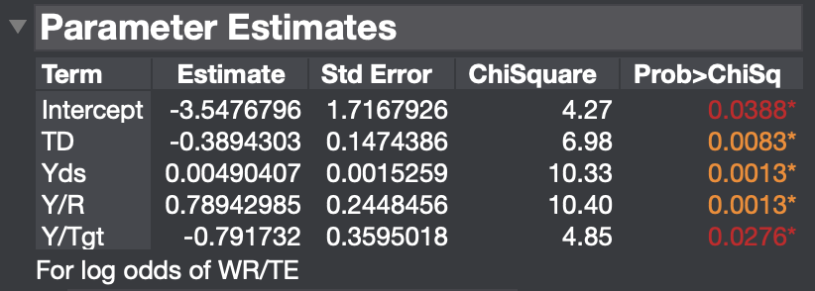
Logistic Regression
y = position (WR/TE)
x₁ = targets
x₂ = receptions
x₃ = touchdowns
x₄ = yards
x₅ = first downs
x₆ = yards per catch
x₇ = yards per target
y = position (WR/TE)
x₃ = touchdowns
x₄ = yards
x₆ = yards per catch
x₇ = yards per target
e-3.5477 - 0.3894(TD) + 0.0049(Yds) + 0.7894(Y/R) - 0.7917(Y/Tgt)
p_{WR} =
1 + e-3.5477 - 0.3894(TD) + 0.0049(Yds) + 0.7894(Y/R) - 0.7917(Y/Tgt)

Slide 4
Logistic Regression
ROC Curve:
p ≥ 0.7071 = predict WR
p < 0.7071 = predict TE
Predict Actual | WR | TE | Totals
WR | 66 | 20 | 86
TE | 7 | 26 | 33
Model Accuracy:
Sensitivity: 66/86 = 0.7674
Specificity: 26/33 = 0.7879

Slide 5
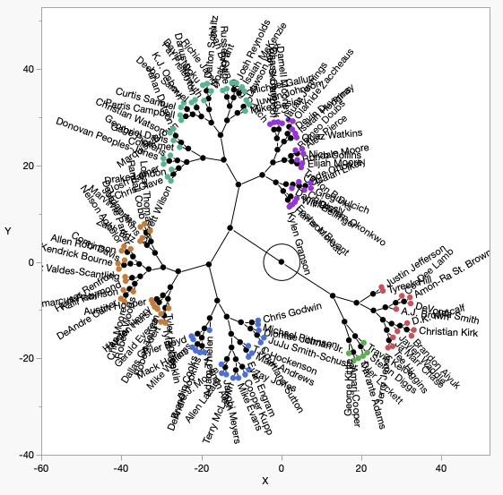
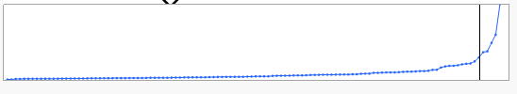
Cluster Analysis
Variables: age, position (WR/TE), receptions, yards, touchdowns
6 distinct clusters
Order of Clusters = Order of player performance
  Cluster 1 is the best, Cluster 6 is the worst
Data from 2022-2023 NFL season
Cluster Observations:

Slide 6
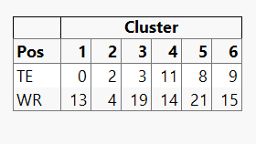
Cluster Analysis: Cross-Tabulation Table
Cluster 1: 100% WR 0% TE
Cluster 2: 66.67% WR 33.3% TE
Cluster 3: 86.36% WR 13.63% TE
Cluster 4: 56% WR 44% TE
Cluster 5: 72.41% WR 27.59% TE
Cluster 6: 62.5% WR 37.5% TE

Slide 7
Conclusion
Developed a logistic regression model to classify players as TE or WR
  4 significant predictors: Touchdowns, Yards, Yards per catch, and Yards Per Target
Cluster analysis grouped players based on performance metrics
  Revealed tiers and output differences across positions
Applications extend beyond modeling to scouting, game planning, and player development.

